Slide 1

Newspaper Boxes: How do they Influence the Pedestrian Flow?
Lecture with Computer Exercises:
Modelling and Simulating Social Systems with MATLAB
Dario Kneubühler, Roman Müller, Anja Sutter, Ueli Wechsler

Slide 2
Overview
Introduction
The Social Force Model
Our Implementation
Evaluation and Results
Difficulties and Outlook

Slide 3
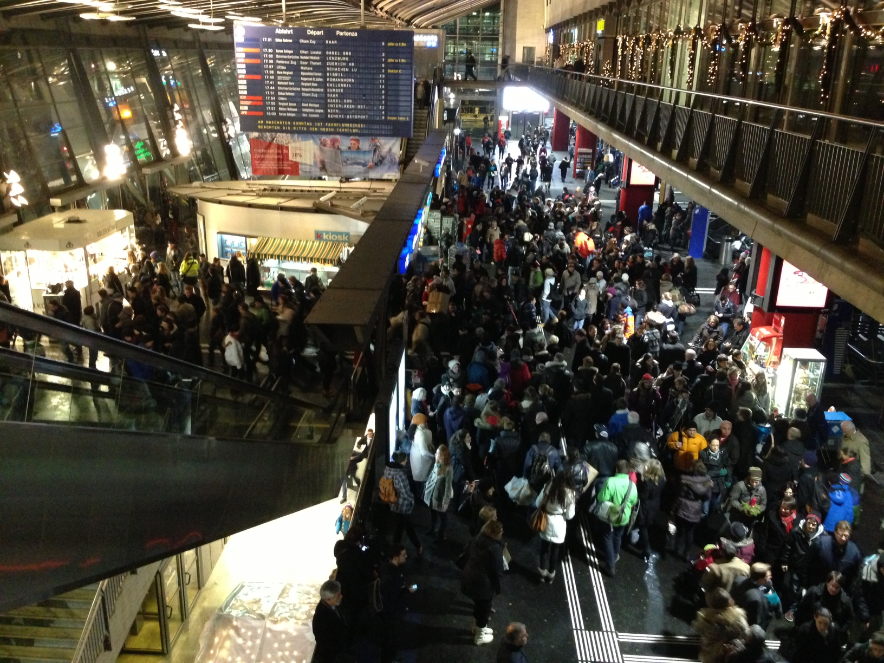
Motivation
Interest in pedestrian dynamics
Question: How do different newspaper box positions influence the time in which pedestrians pass a certain route?

Slide 4
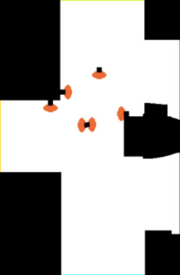
Environment
Map of the Train Station in Lucerne
6 Different Positions for the Paperbox

Slide 5
The Social Force Model
Describes pedestrians as particles
3 forces act on the pedestrians
Destination Force
Pedestrian Force
Wall Force

Slide 6
The Social Force Model
Describes pedestrians as particles
3 forces act on the pedestrians
Destination Force
Fast Marching
Pedestrian Force

Slide 7
The Social Force Model
Describes pedestrians as particles
3 forces act on the pedestrians
Super positioned → Total Force
Integrated twice → Position

Slide 8
Implementation

Slide 9
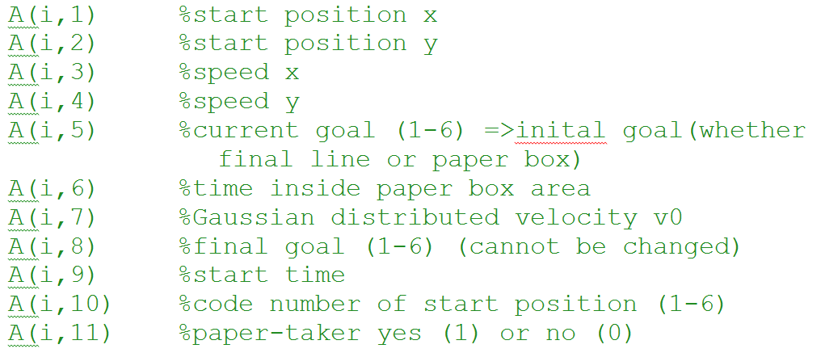
Agents-Matrix
One row per agent

Slide 10
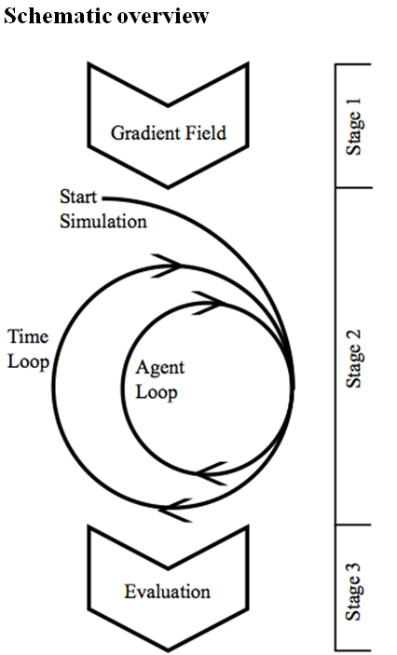
Pseudo-code
execute pre-work (stage 1)
distinct entries, wall and free space
compute distance maps (with Fast Marching)
calculate gradient fields
simu (stage 2)
convert gradient field into force field
get image for plot
time loop
| initialisation
| agent loop
| | calculate destination force
| | calculate the walls’ force
| | calculate the other agents’ force
| | int
| | exit2
| | destination change
| plot
evaluation (stage 3)

Slide 11
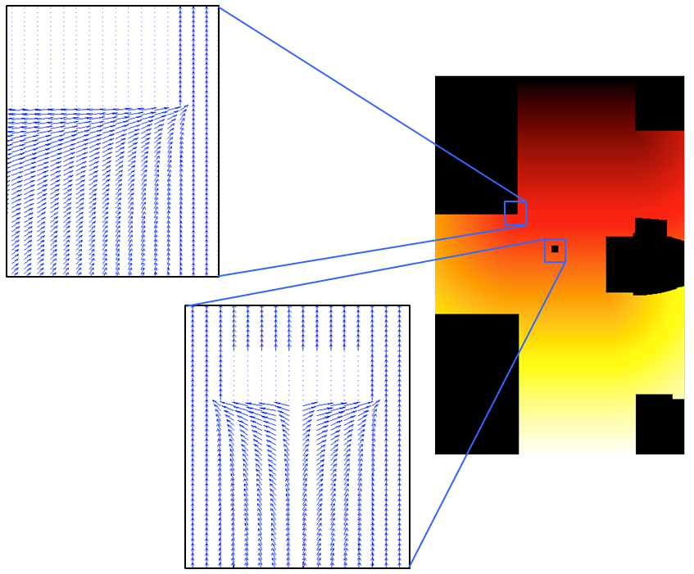
Destination Force
Fast marching
Gradient of distancemap
6 gradient fields

Slide 12
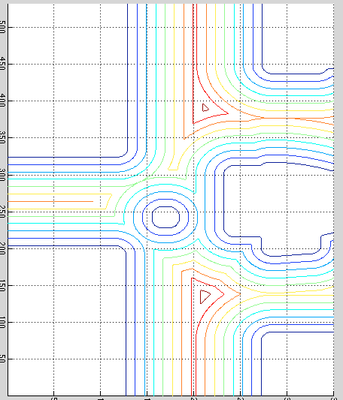
Walls repulsion force
Distance map (fast-m.)
Gradient field
Exponential increasing

Slide 13
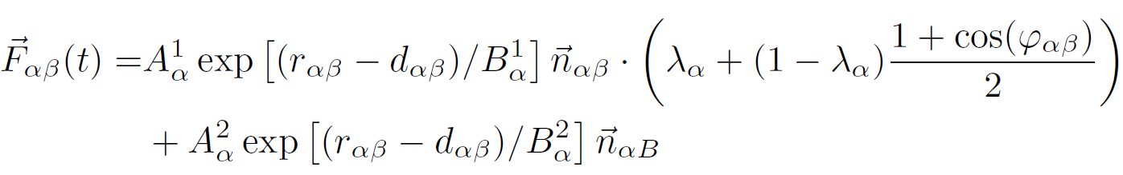
Other agents’ repulsion Force
Elliptical equipotential line
Approximation (Helbing)

Slide 14
Evaluation
Four runs of each situation
Outcome:
histogram, median, plots, videos, …
Analyse diverse and interesting results

Slide 15
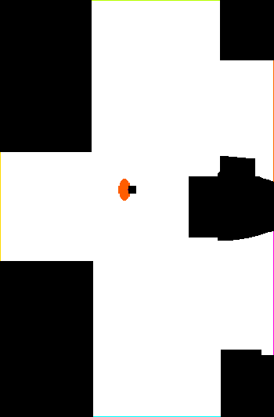
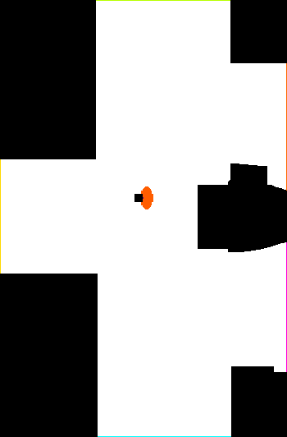
Results:
Median all passersby
 | all | paper-takers only
A | 28.30s | 56.80s
B | 29.10s | 63.08s
C | 28.25s | 45.20s
D | 29.80s | 63.63s
E | 28.45s | 49.65s
F | 29.28s | 65.40s
same position!
most diverse

Slide 16

C vs D
C
D

Slide 17
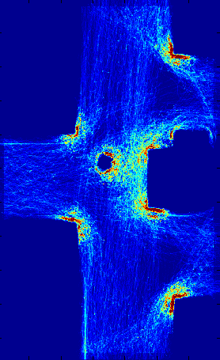
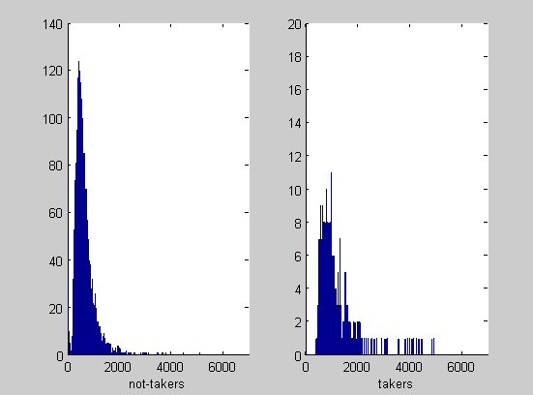
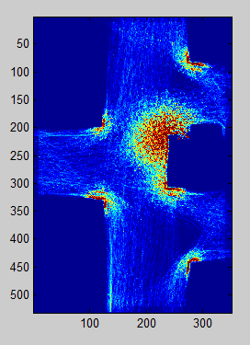
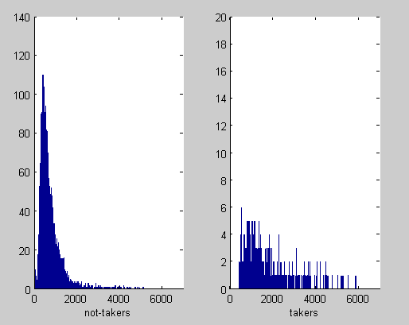
C versus D
 | all | paper-takers only | without paper-takers
C | 28.25s | 45.20s | 27.25s
D | 29.80s | 63.63s | 28.70s
C-D | -1.55s | -18.43s | -1.45s

Slide 18
Video

Slide 19
Difficulties
Modelling Human Behaviour
Repulsion Forces of Walls
Edges
Definition of the Parameters
Time Intensive Debugging
Interpretation of the Results

Slide 20
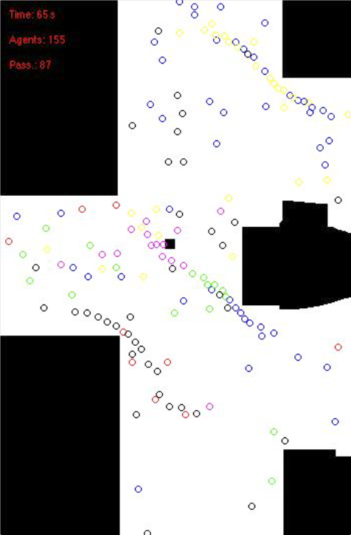
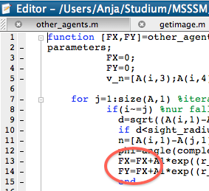
Wrong Parameters?

Slide 21
Difficulties
Modelling Human Behaviour
Repulsion Forces of Walls
Edges
Definition of the Parameters
Time Intensive Debugging
Interpretation of the Results

Slide 22
Outlook
Round Edges
Evaluation of Parameters
Real Time Fast Marching Algorithm
More Time for Simulation and Evaluation

Slide 23
QUESTIONS?

Slide 24
THANK YOU!

